Slide 1


DOM
Dissolved Organic Matter (2023FA)
Investigating the optimal conditions to remove humic acid in drinking water
More at https://github.com/AguaClara/Dissolved-Organic-Matter
Zachary Kwon | zk49@cornell.edu Nhi Nguyen | npn25@cornell.edu
Rachel Lai | rml267@cornell.edu Henry Lin | hl777@cornell.edu
Dissolved Organic Matter | Research | Symposium Presentation Fall 2023 | Page 1
Notes:
Henry
We are the Dissolved Organic Matter (DOM) subteam. Our mission is to investigate the optimal conditions to remove humic acid (our tested form of dissolved organic matter) in drinking water. You all can find out more about our subteam’s work at this Github link. [Let everyone introduce themselves]

Slide 2
Table of Contents
Goal
Background
Relevance to Gracias Plant
Schematic Drawing
Experimental Setup
Current Work
Results and Analysis
Future Work
Dissolved Organic Matter | Research | Symposium Presentation Fall 2023 | Page 2
Notes:
Henry
Here is a general breakdown of our presentation today. We’ll start off with some general background and technical information before talking about our current research, results, and future plans.

Slide 3
Goal
To determine the effectiveness of implementing coagulant with clay and/or powdered activated carbon to remove humic acid from drinking water and improve the capability of AguaClara water treatment plants.
Dissolved Organic Matter | Research | Symposium Presentation Fall 2023 | Page 3
Notes:
Henry
Our mission this semester is to focus on determining the effectiveness of implementing coagulant with clay and/or powdered activated carbon to remove humic acid from drinking water to improve the capability of AguaClara water treatment plants.

Slide 4
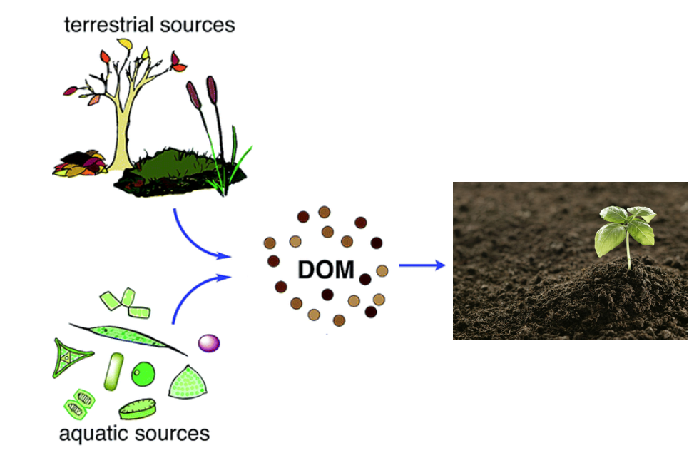
Background
What is humic acid (HA)?
Color, taste and odor problems
Increased heavy metals and organic pollutants
How can we deal with humic acid?
Flocculation
Coagulant (PACl)
w/ Clay
w/ Powdered Activated Carbon (PAC)
Create denser flocs
Porous and hydrophobic particles
Higher molar masses
Figure 1. Formation of dissolved organic material from terrestrial and aquatic sources
Dissolved Organic Matter | Research | Symposium Presentation Fall 2023 | Page 4
Notes:
Henry
What is humic acid?
Humic acid is a type of Dissolved Organic Matter (DOM), which consists of particles present in surface and groundwater and mainly results from plant and animal decay. Although humic acid is beneficial to plants because of their stimulation for plant growth and increase of plant disease resistance, it is viewed as a problem for the drinking water treatment process. This is because humic acid causes problems with the color, taste, and odor of drinking water and is associated with increased levels of complex heavy metals and adsorbed organic pollutants.
How can we deal with humic acid in drinking water?
Our subteam’s method for removing humic acid from drinking water is through a process known as flocculation. Flocculation is driven by coagulant, which is a substance that clumps the impurities in water together in bunches -called flocs- that can be easily removed in the sedimentation tank.
After deciding on a set dosage of coagulant, we shifted our focus to finding the optimal coagulant to clay and/or activated carbon ratio that can maximize the amount of humic acid removed from the overall system. This is because both clay and PAC are able to create denser flocs since they are made up of porous and hydrophobic particles and have a higher overall molar mass.
Information Citation:
Radian, A., &amp; Mishael, Y. (2012). Effect of humic acid on pyrene removal from water by polycation-clay mineral composites and activated carbon. Environmental Science &amp; Technology, 46(11), 6228–6235. https://doi.org/10.1021/es300964d
Image citation:
Lin, V. S. (2015). Research highlights: Challenges in the characterization, storage, and isolation of natural organic matter. Environmental Science: Processes & Impacts, 17(12), 2002–2005. https://doi.org/10.1039/c5em90046h

Slide 5
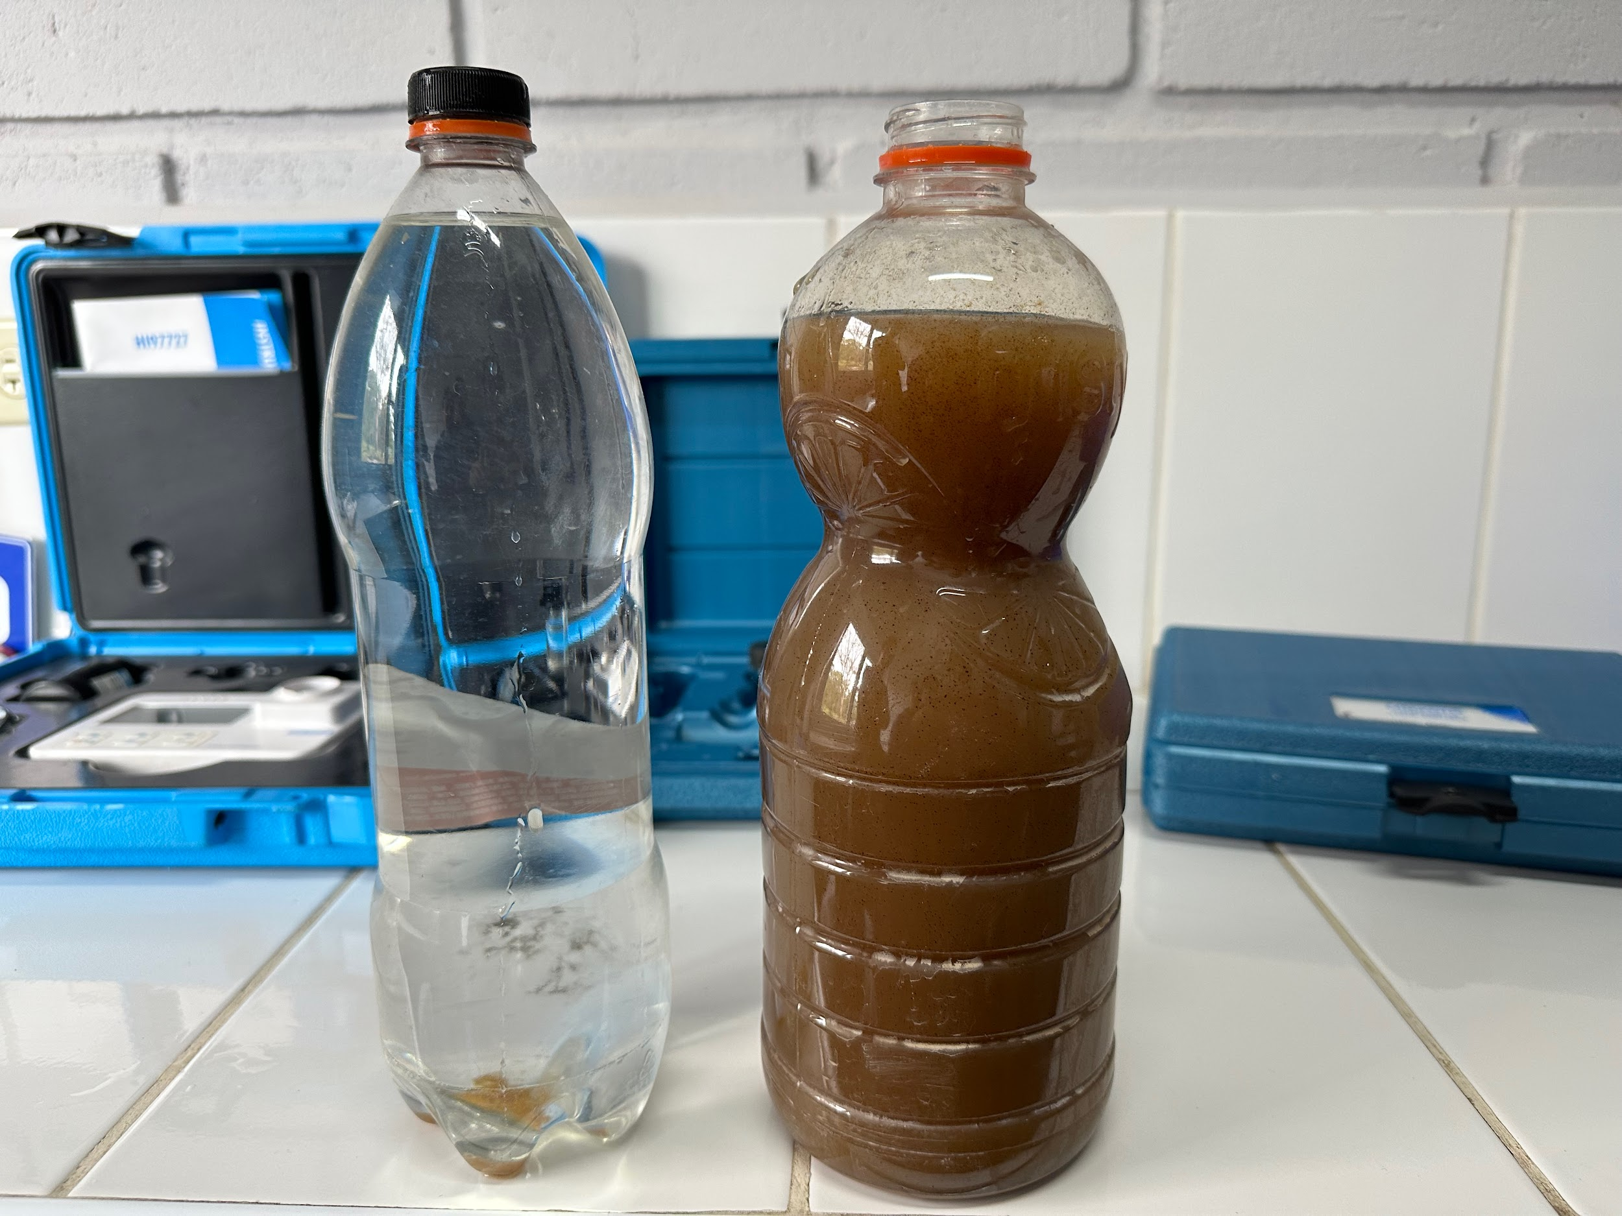
Relevance to Gracias Plant
Flocculation issues:
Low turbidity of influent stream
Pigments particles from sweet gum (liquidambar) tree
Too small for coagulant to combine
Reduce PaCl's effectiveness in flocculation
Figure 2. Influent (left) and effluent (right) water from the Gracias plant (Honduras) during the rainy season
Dissolved Organic Matter | Research | Symposium Presentation Fall 2023 | Page 5
Notes:
Henry
Why do we care?
Affects the effectiveness of the Gracias plant
Gracias plant is the largest Aguaclara plant, its flow is 120L/s
What caused the flocculation issue at the Gracias plant?
This influent stream has a partially high concentration of leaves from the liquidambar tree. the leaves have a pigment that gets into the water
The pigment is bad for aesthetic reasons, no one wants to drink brown water
But more importantly, the pigment is bad because it hinders the effectiveness of flocculation process.
So now, you are probably wondering, how do the pigments cause flocculation issues?
For one, the pigments particles are too small to allow coagulant to combine to them
Secondly, the pigment is so prevalent that it reduces the PaCl's effectiveness in helping floc forms.
Currently in Honduras, plant operators are adding clay to help flocs form.
Extra info, don’t need to say: but the operators are unsure how much to add. they are guessing. sometimes they could use too much or too little
Our task: we need to figure out a formula/ratio of how much clay to add (or other coagulant) that will allow flocs to form efficiently, and optimize costs.
We also need turbidity to create flocs
Gracias has a low turbidity influent stream (during dry season) and this hinders the ability to form flocs
We are modeling this by using low turbidity setup in our lab to mimic conditions in gracias

Slide 6
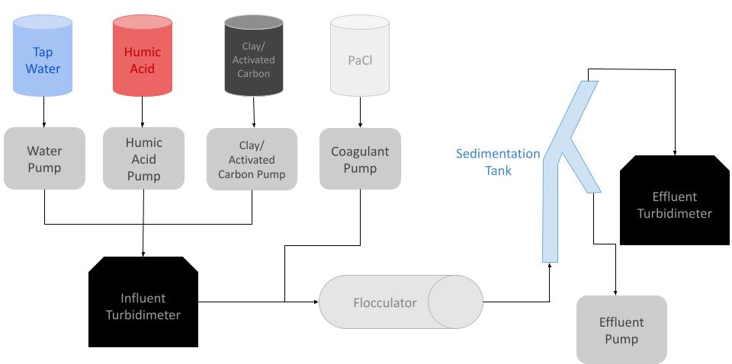
Schematic Drawing
Figure 3. Schematic drawing of the experimental set up for testing varying clay and/or activated carbon concentrations
Dissolved Organic Matter | Research | Symposium Presentation Fall 2023 | Page 6
Notes:
Nhi
We have a similar schematic for the other experiments we will like to run. The main differences is that there will not be clay added to the humic acid solution and that we will have another pump with activated carbon which will combine with humic acid and water before entering the influent turbidimeter.
The reason why there is a separate bottle for the clay solution is since we will be varying the flow rate of clay via ProCoDA to vary its concentration in the flocculator. The previous schematic was set up to
Have a dose of humic acid in clay solution so that the clay particle would be negatively charged and not agglomerate.
Facilitate manual change of clay concentration by adding more clay to the current stock humic acid and clay solution while ProCoDA’s flow rate is kept constant.
However, having a separate clay solution with a fixed concentration and only changing its flow rate into the system through ProCoDA allows for more flexibility and accuracy. The agglomeration of clay particles can be prevented by mixing a low dose of humic acid into the clay stock. With this in mind, we opt for this approach and schematic this semester.

Slide 7
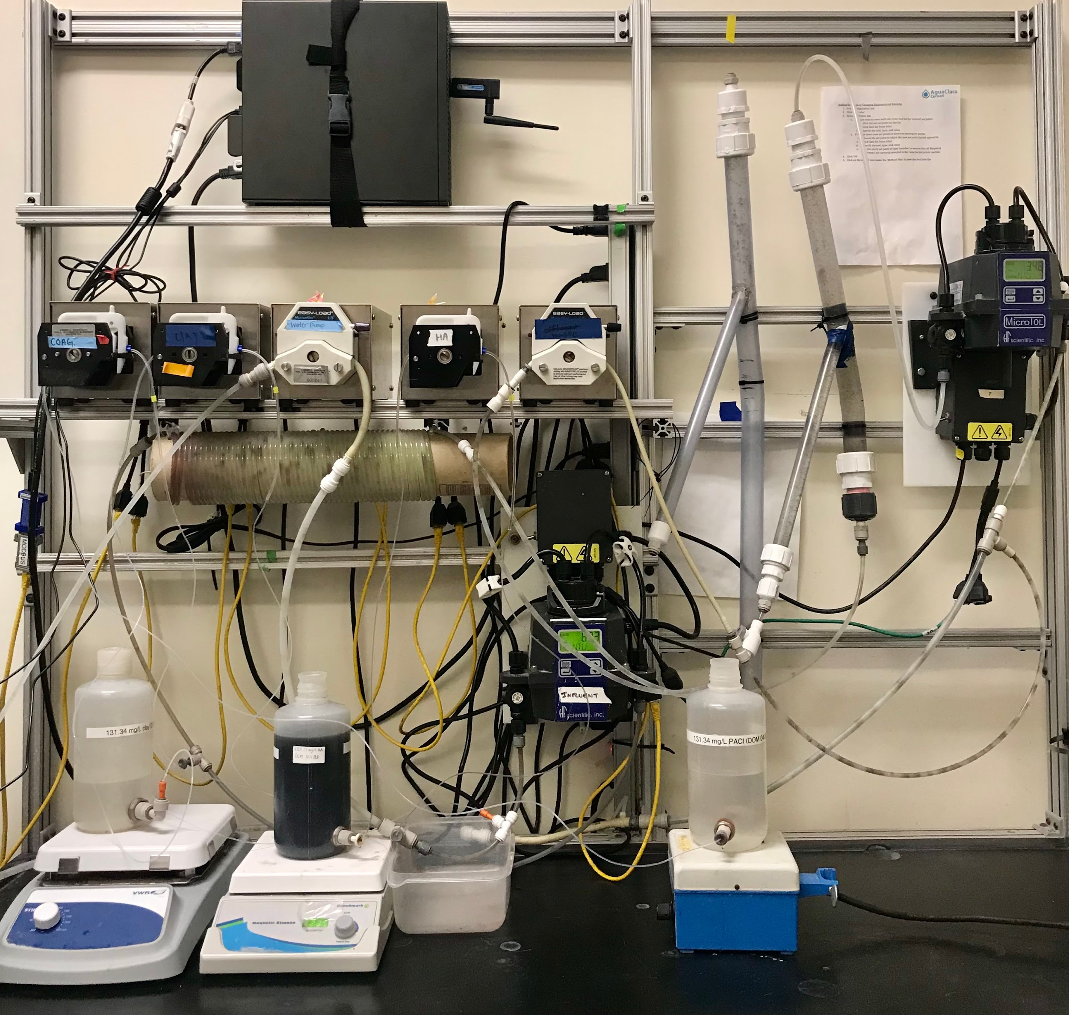
Experimental Setup
Water pump
New Sedimentation tank
Coagulant pump
Effluent turbidimeter
Clay/activated carbon pump
Wastewater pump
Humic acid pump
Flocculator
Influent turbidimeter
Figure 4. Image of lab set-up and experimental design
Dissolved Organic Matter | Research | Symposium Presentation Fall 2023 | Page 7
Notes:
Nhi
As you see from the schematic drawings, our system plays around five main pumps: one for coagulant, activated carbon, humic acid, and water. And an addition one for wastewater to ensure that the final solutions leaves the system.
As a general overscope of how system runs. (This portion is repeated already in Slide 6) Water is pumped from the inlet and combines with the humic acid and activated carbon which then goes into the influent turbidimeter, which gives us our initial readings. Then coagulant is introduced into the stream and it passes through the flocculator. After the flocculator, the solution goes into the sedimentation tank, where the flocs are expected to settle out, and we are able to obtain our final readings in the effluent turbidimeter.

Slide 8
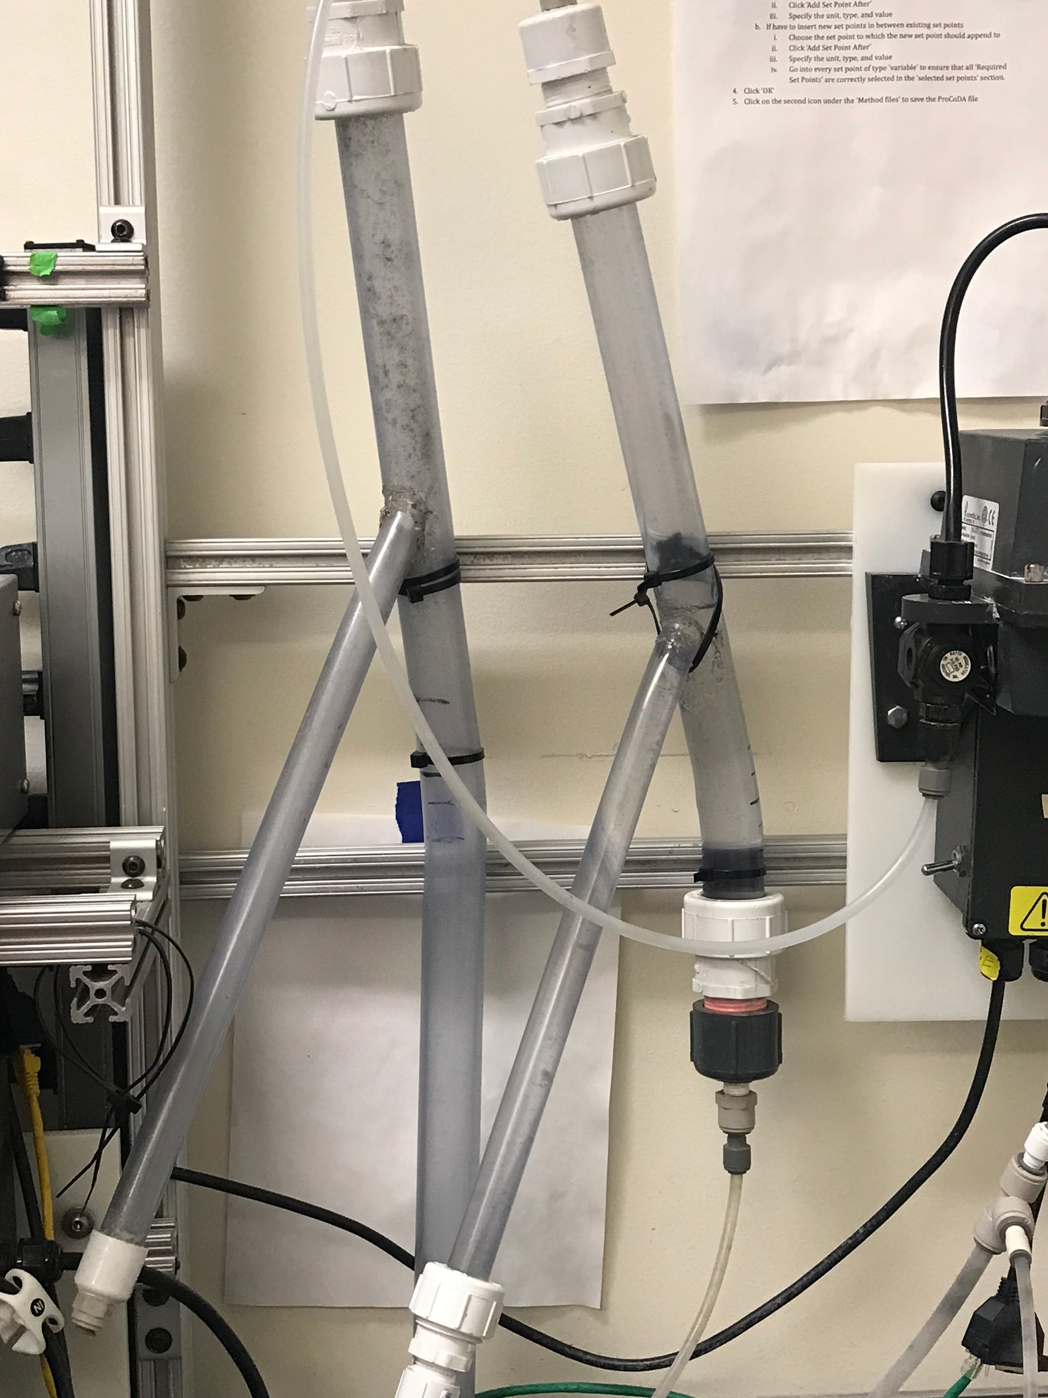
Current Work
Preparation of new sedimentation tank
Reduce residence time
Prevent the formation of a floc blanket
60° angle
New sedimentation tank that was cut
Previous sedimentation tank
Figure 5. Installation of new sedimentation tank
Dissolved Organic Matter | Research | Symposium Presentation Fall 2023 | Page 8
Notes:
Nhi
When testing the upflow velocity, several additional adjustments were made to the system as well to accommodate for the discrepancy of the testing. One of the main adjustments was the preparation of a new sedimentation tank. The new sedimentation tank was cut to reduce the time for the system to travel through the sedimentation tank and prevent the formation of a floc blanket. The tank was cut using an electric reciprocating saw at roughly ~9 cm below the bent portion of the tank. The new shorter sedimentation tank was installed to the right of the original tank and secured such that the upper arm formed a 60° angle with the horizontal for effective separation of flocs. The 60° angle adjustment was made to ensure that there is a large enough planar area for the flocs to settle on and eventually enter the lower arm, thus leaving the system.

Slide 9
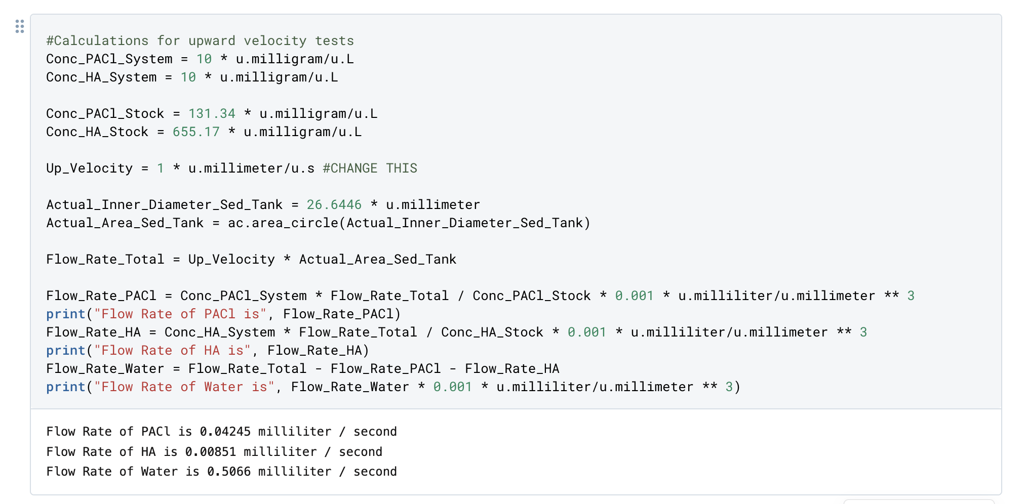
Current Work
Figure 6. Deepnote Code for Calculating Flow Rates In the System
Dissolved Organic Matter | Research | Symposium Presentation Fall 2023 | Page 9
Notes:
Zach
The optimal upflow velocity for the system needed to be determined by running trials with only humic acid, coagulant, and water. By increasing the upflow velocity in the sedimentation tank, the system would reach failure and serve as a control group to verify the effectiveness of adding clay and/or activated carbon into the system. The purpose of this experimentation process is to provide a contrast between a system with and without clay/activation carbon through creating an environment where flocs are unable to form when only humic acid and coagulant are supplied. Calculations for the flow rates necessary to determine the optimal upflow velocity were made with Deepnote, a collaborative coding program. We developed this Python code based on code from Monroe’s AguaClara textbook to calculate the flow rates necessary to test different upward velocities. With this code, we have the ability to fluidly change system concentrations, stock concentrations, and upward velocities.

Slide 10
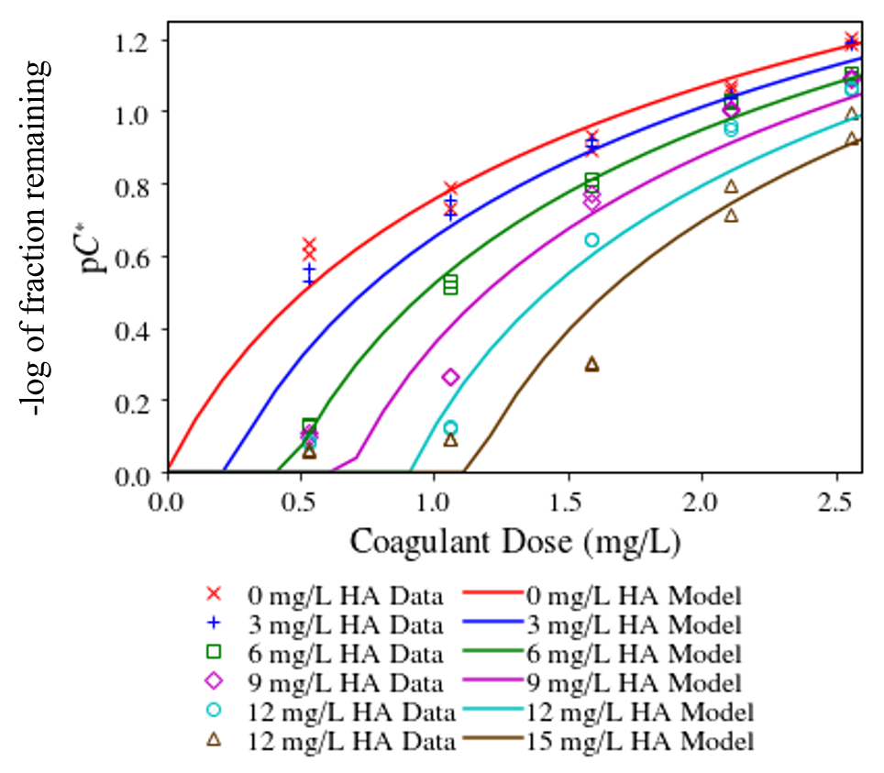
Figure 7. Flocculation performance as a function of coagulant dose and humic acid concentration
Current Work
Dissolved Organic Matter | Research | Symposium Presentation Fall 2023 | Page 10
Notes:
Zach
To determine the humic acid and coagulant dosages with Deepnote, it was necessary to determine as a subteam what their respective concentrations should be set at in the system. Based on the data from Du et al. (2019) in Figure 7, a value of 25 mg/L for system humic acid concentration was extrapolated and values between 2-3 mg/L for system coagulant concentration were chosen for this experiment. We chose these values because we wished to decrease the amount of flocs that successfully left the system by minimizing the relative system coagulant concentration. Therefore, when adding clay and/or activated carbon, we can better see how much the level of flocculation increases.
Graph Citation:
Du, Y., Pennock, W. H., Weber-Shirk, M. W., & Lion, L. W. (2019). Observations and a Geometric Explanation of Effects of Humic Acid on Flocculation. Environmental Engineering Science, 36(5), 614-622. http://doi.org/10.1089/ees.2018.0405

Slide 11
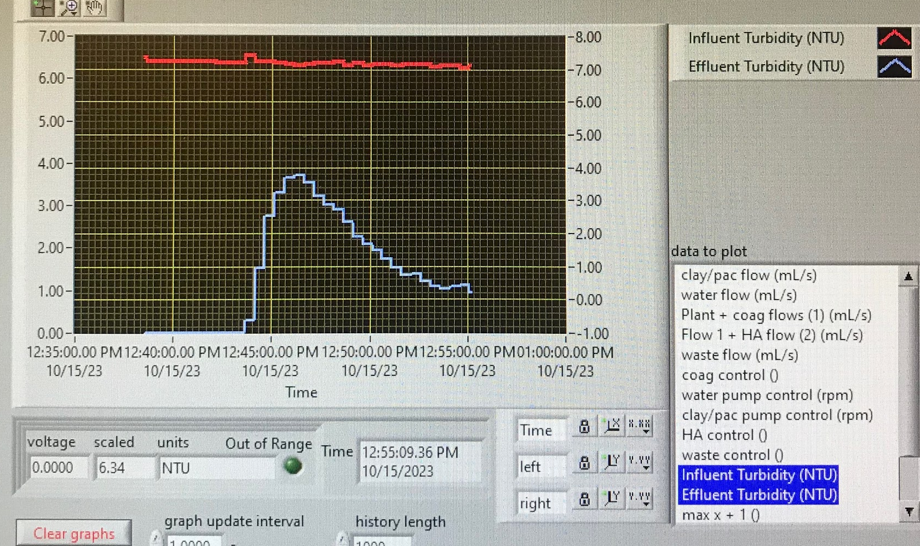
Current Work
Trial 1: 1.5 mm/s upflow velocity (~ 20 mins)
([PACl] = 3 mg/L in system, [HA] = 25 mg/L in system)
Observations:
Effluent NTU was dropping consistently and began to flatten out
Figure 8. ProCoDA graph of the influent and effluent turbidites with a 1.5 mm/s upflow velocity in sedimentation tank
Dissolved Organic Matter | Research | Symposium Presentation Fall 2023 | Page 11
Notes:
Rachel
Our current goal is to create a system that fails where the effluent turbidity is equal to the influent turbidity which means the dirty water created is also leaving where our clean water is collected.
The upflow velocity is the velocity of fluid in the sedimentation tank. When we increase the upflow velocity, it creates a harsher environment for flocs to form and thus increases the effluent turbidity. However, we want to find the minimum upflow velocity just when the system starts to fail. We first tested with 1.5 mm/s for 20 mins based on the values from our current slide. From our experiment, the effluent turbidity increased but then dropped consistently to flatten out.

Slide 12
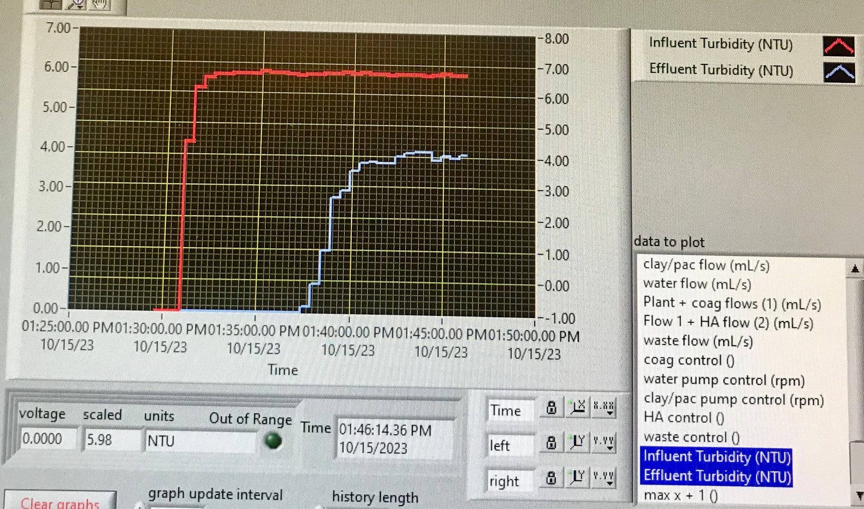
Current Work
Trial 2: 2 mm/s upflow velocity (~ 16 mins)
([PACl] = 3 mg/L in system, [HA] = 25 mg/L in system)
Observations:
Effluent NTU increased and then began to flatten out
Figure 9. ProCoDA graph of the influent and effluent turbidites with a 2 mm/s upflow velocity in sedimentation tank
Dissolved Organic Matter | Research | Symposium Presentation Fall 2023 | Page 12
Notes:
Rachel
In the next trial, we increased the upflow velocity to 2 mm/s for 16 mins. The effluent turbidity here increased and flattened out instead of dropping.

Slide 13
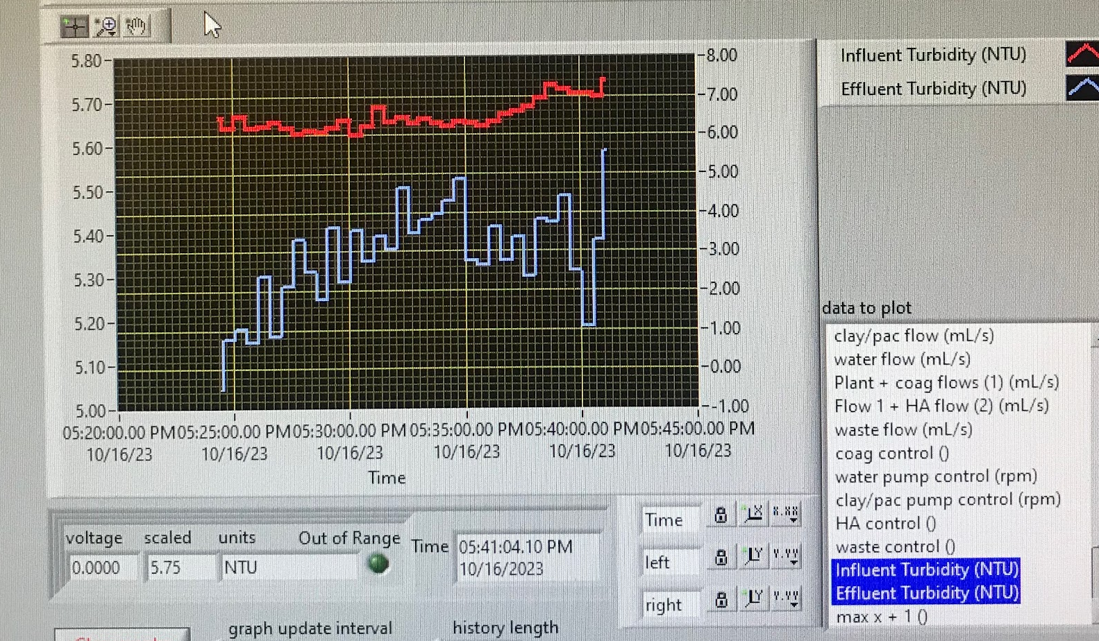
Current Work
Trial 3: 3 mm/s upflow velocity (~ 50 mins)
([PACl] = 2 mg/L in system, [HA] = 25 mg/L in system)
Observations:
Effluent NTU is closer to the influent NTU
Figure 10. ProCoDA graph of the influent and effluent turbidites with a 3 mm/s upflow velocity in sedimentation tank
Dissolved Organic Matter | Research | Symposium Presentation Fall 2023 | Page 13
Notes:
Rachel
We increased the upflow velocity again to 3 mm/s for 50 mins. A thing to note is that we decreased the coagulant concentration to make it more difficult for flocs to form. The y-axis is zoomed in a lot more and the effluent turbidity is now much closer to the influent turbidity.

Slide 14
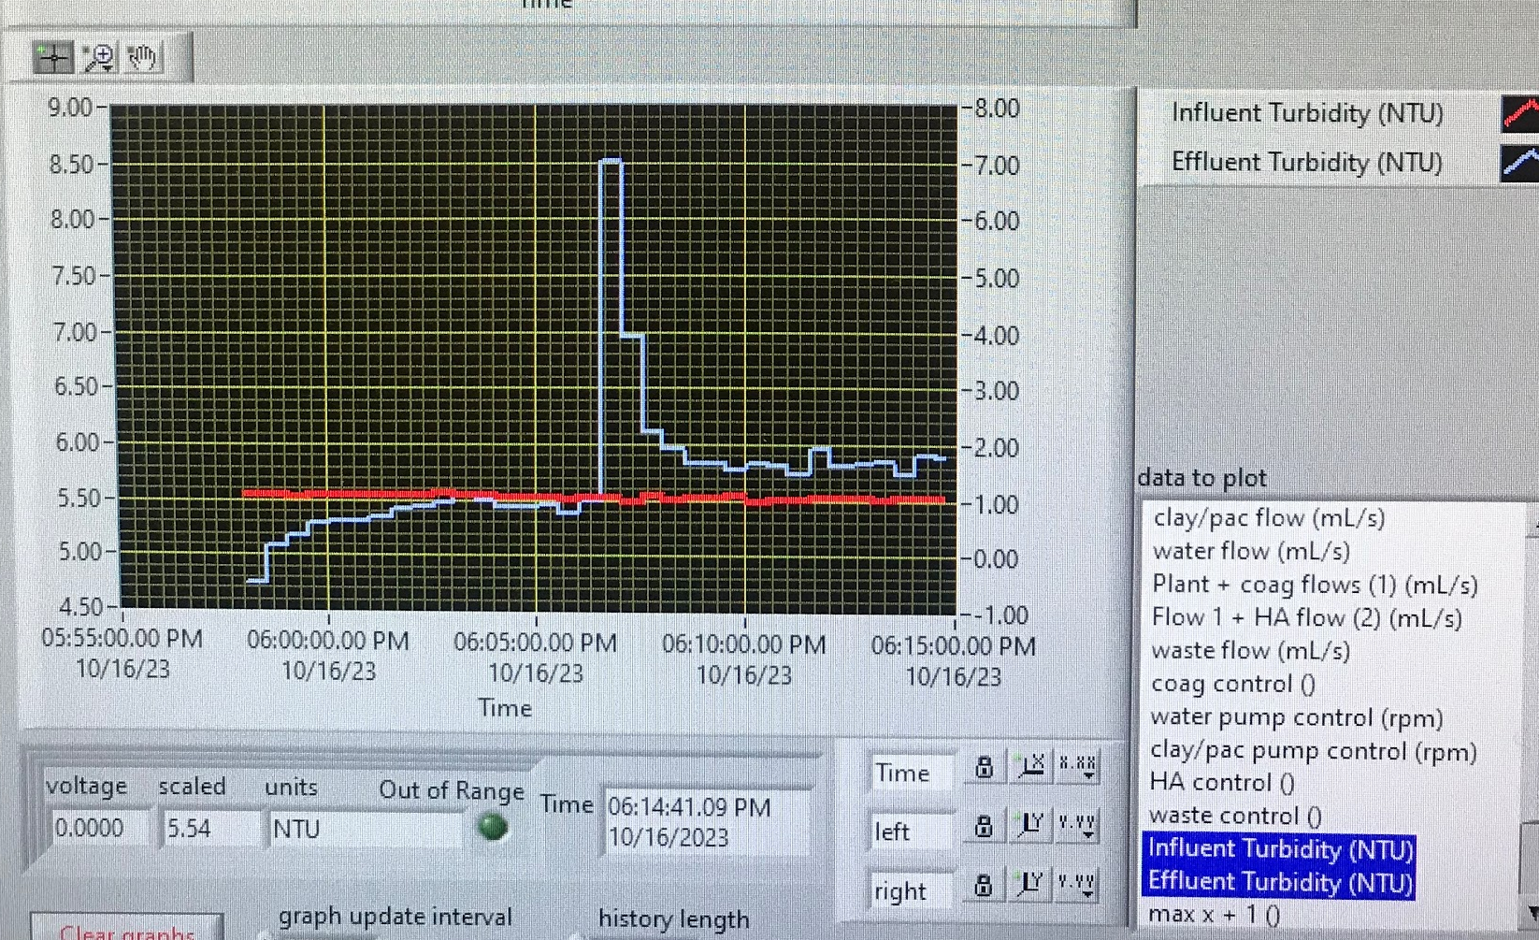
Current Work
Trial 4: 3.5 mm/s upflow velocity (~ 84 mins)
([PACl] = 2 mg/L in system, [HA] = 25 mg/L in system)
Observations:
Effluent NTU eventually became higher than the influent NTU
Figure 11. ProCoDA graph of the influent and effluent turbidites with a 3.5 mm/s upflow velocity in sedimentation tank
Dissolved Organic Matter | Research | Symposium Presentation Fall 2023 | Page 14
Notes:
Rachel
We increased the upflow velocity again to 3.5 mm/s for 84 mins to see if we can get the effluent turbidity to be even closer to the influent turbidity. It was successful, however the effluent eventually became slightly higher than the influent turbidity.

Slide 15
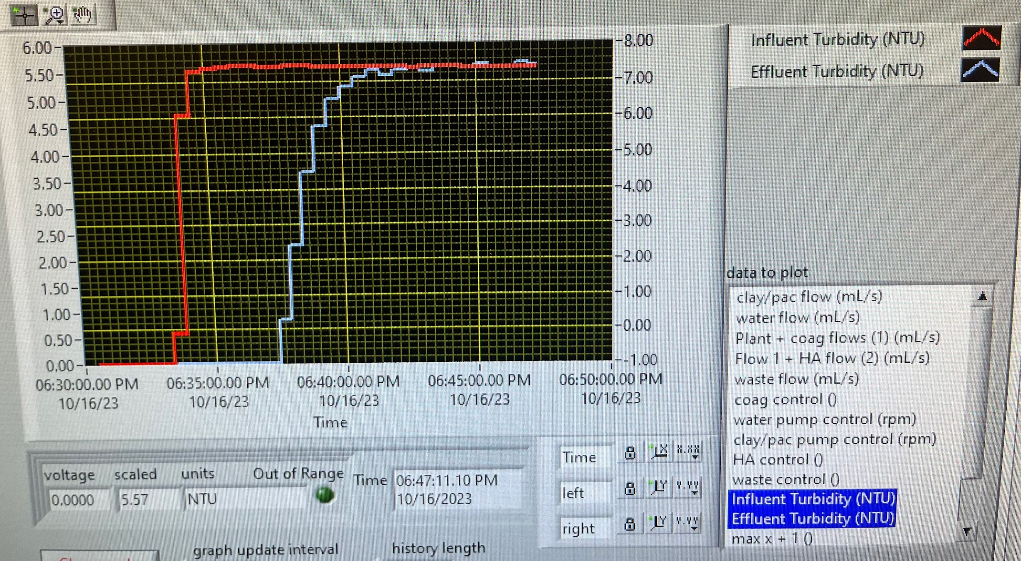
Current Work
Trial 5: 3.25 mm/s upflow velocity (~ 84 mins)
([PACl] = 2 mg/L in system, [HA] = 25 mg/L in system)
Observations:
Effluent NTU is now slightly higher than the influent NTU
Figure 12. ProCoDA graph of the influent and effluent turbidites with a 3.5 mm/s upflow velocity in sedimentation tank
Dissolved Organic Matter | Research | Symposium Presentation Fall 2023 | Page 15
Notes:
Rachel
We decreased the upflow velocity again to 3.25 mm/s for 84 mins to see if we can get the effluent turbidity can level out slightly below the influent turbidity. The effluent turbidity was closer to the influent turbidity. However, it is still slightly above the influent line.

Slide 16
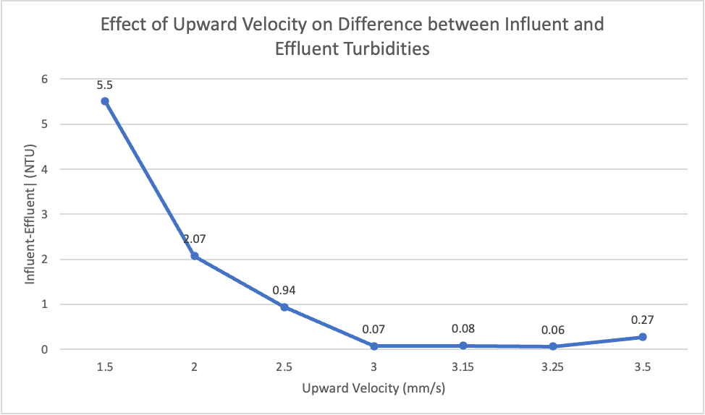
Result and Analysis
Upflow Velocity (mm/s) | Influent (NTU) | Effluent (NTU)
1.5 | 6.33 | 0.83
2 | 5.99 | 3.92
2.5 | 5.69 | 4.75
3 | 5.75 | 5.68
3.15 | 5.57 | 5.65
3.25 | 5.64 | 5.58
3.5 | 5.53 | 5.8
Table 1: Summary of the upflow velocities and turbidites
Figure 13. Graph of upward velocities vs change in effluent and influent turbidites
The influent and effluent readings gets closer together as upward velocity increases
=> 3.25 mm/s upward velocity yields closest turbidity readings for influent and effluent.
Dissolved Organic Matter | Research | Symposium Presentation Fall 2023 | Page 16
Notes:
Rachel
We summarized the findings of the upflow velocities and the change in turbidites in Table 1 and Figure 13 to determine the optimal upflow velocity to run our experiments in which will be 3.15 which is in the middle of 3 and 3.25 mm/s.

Slide 17
Future Work
Conduct experiments involving the incremental addition of clay in an arithmetic progression
Create new ProCoDA file to achieve this
Rigorously check datalogs to create Turbidity vs. Time graphs with Excel
Compare results for clay trials with activated carbon trials
Dissolved Organic Matter | Research | Symposium Presentation Fall 2023 | Page 17
Notes:
Zach
Conduct experiments involving the incremental addition of clay in an arithmetic progression
Create new ProCoDA file to achieve this
Rigorously check datalogs to create Turbidity vs. Time graphs with Excel
Compare results for clay trials with activated carbon trials

Slide 18
Questions
and/or
Recommendations?
Zachary Kwon | zk49@cornell.edu Nhi Nguyen | npn25@cornell.edu
Rachel Lai | rml267@cornell.edu Henry Lin | hl777@cornell.edu
Dissolved Organic Matter | Research | Symposium Presentation Fall 2023 | Page 18
Notes:
Thank you for listening to our presentation. If you have any questions or recommendations, feel free to contact anyone on the team!

Slide 19
Appendix
Slides
Dissolved Organic Matter | Research | Symposium Presentation Fall 2023 | Page 19

Slide 20
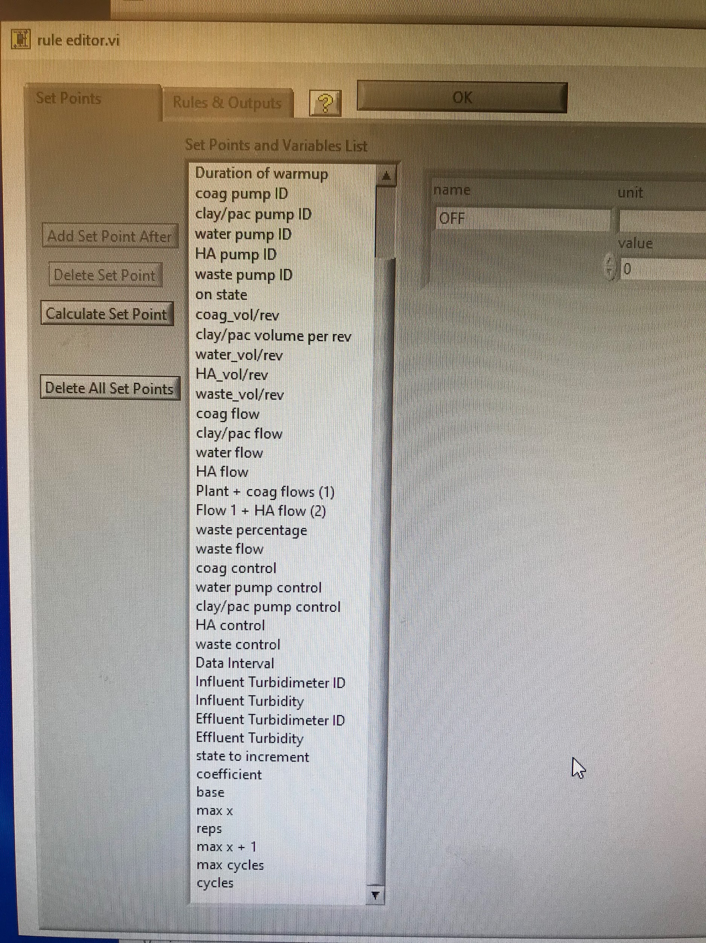
ProCoDA Set Points
Figure 13. Image of the setpoints of the ProCoDA method file
Link to ProCoDA Method File: https://github.com/AguaClara/Dissolved-Organic-Matter/blob/main/ProCoDA-Method-Files/DOM%2004232023%20automated%20trials.pcm
Dissolved Organic Matter | Research | Symposium Presentation Fall 2023 | Page 20
Notes:
Attached above is an image of our ProCoDA setpoints and a link to the DOM 04/23/2023 automated trials ProCoDA method file on Github

Slide 21
References
Logan, B. E., Hermanowicz, S. W., & Parker, A. S. (1987). A Fundamental Model for Trickling Filter Process Design. Journal (Water Pollution Control Federation), 59(12), 1029–1042.
Matilaninen, A, Vepsalainen, M & Sillanpaa, M. (2010). Natural Organic Matter Removal by Coagulation during Drinking Water Treatment. Adv Colloid Interface Sci.
Soh, YC, Roddick, F & Van Leeuwen, J. (2008). The Impact of Alum Coagulation on the Character, Biodegradability and Disinfection By-product Formation Potential of Reservoir Natural Organic Matter (NOM) Fractions. Water Sci Technol. 58(6), 1173-9.
Kopfler, F., H. Ringhand, W. Coleman, AND J. Meier. REACTIONS OF CHLORINE IN DRINKING WATER, WITH HUMIC ACIDS AND 'IN VIVO'. U.S. Environmental Protection Agency, Washington, D.C., EPA/600/D-84/196 (NTIS PB85160737).
Du, Y. (2017). Observations and a Geometric Explanation of the Effects of Humic Acid on Flocculation.
Du, Y., Pennock, W. H., Weber-Shirk, M. W., & Lion, L. W. (2019). Observations and a Geometric Explanation of Effects of Humic Acid on Flocculation. Environmental Engineering Science, 36(5), 614-622. http://doi.org/10.1089/ees.2018.0405
Lin, V. S. (2015). Research highlights: Challenges in the characterization, storage, and isolation of natural organic matter. Environmental Science: Processes & Impacts, 17(12), 2002–2005. https://doi.org/10.1039/c5em90046h
Dissolved Organic Matter | Research | Symposium Presentation Fall 2023 | Page 21

